Slide 1



UNIT 4
LESSON 14
Q for a question
Part 2

Slide 2
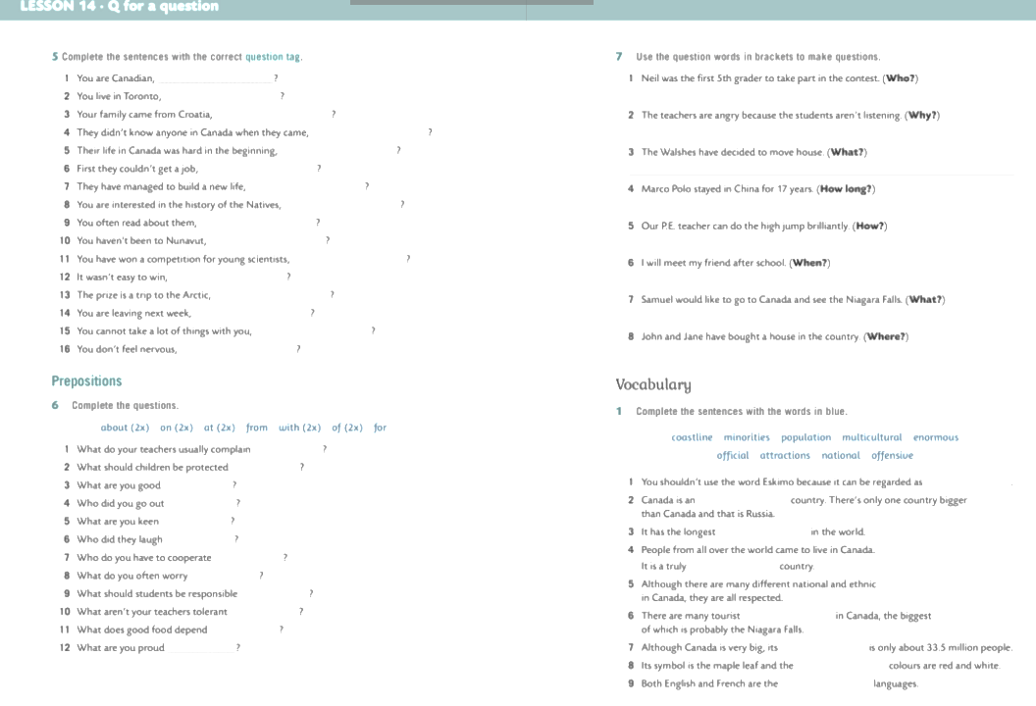
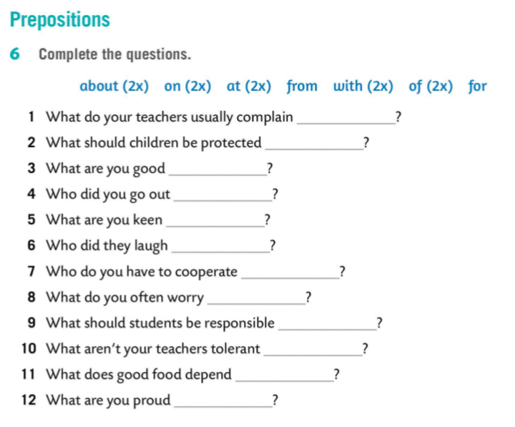
about
from
at
with
on
at
with
about
for
of
on
of

Slide 3
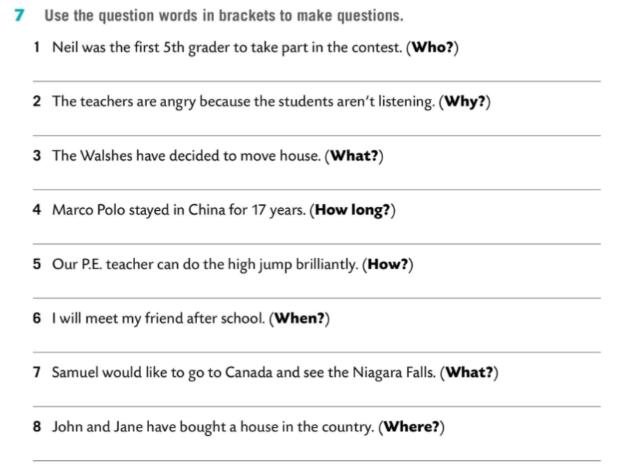
Who was the first 5th grader to take part in the contest?
Why are the teachers angry?
What have the Walshes decided to do?
How long did Marco Polo stay in China?
How can your PE teacher do the high jump?
When will you meet your friend?
What would Samuel like to see in Canada?
Where have John and Jane bought a house?

Slide 4
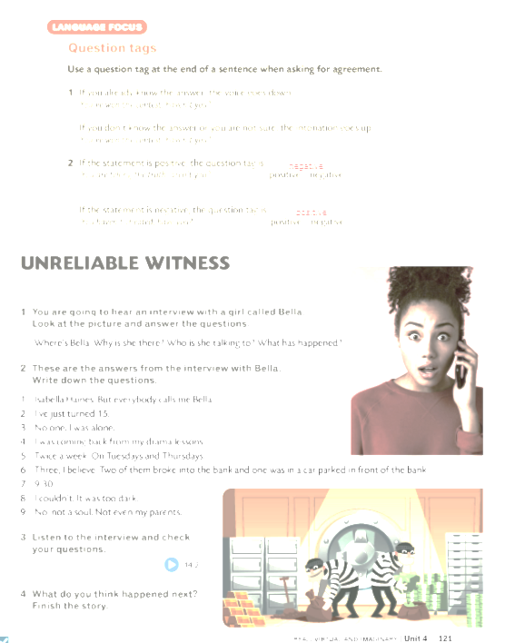
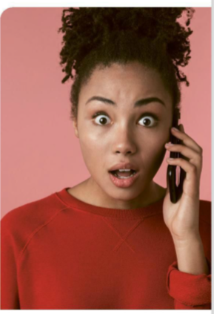

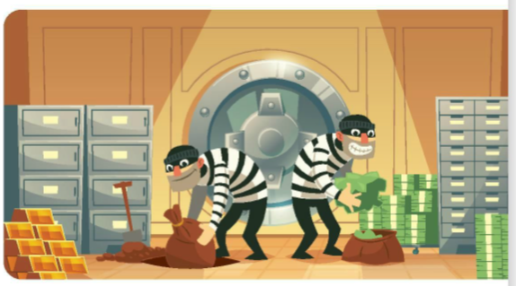
robbery
detective
witness
car
Bella
detective films
drama lessons
CSI: New York
dark

Slide 5
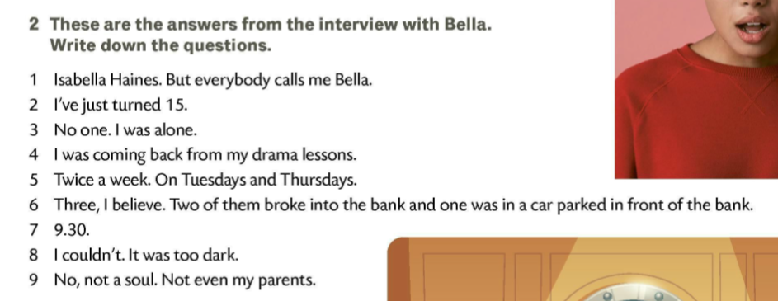

5 How often do you have your classes?
6 How many robbers were there?
1 What’s your name?
7 What time was it?
2 How old are you?
8 Could you see their faces?
3 Who were you with?
9 Have you told anyone else about it?
4 What were you doing there that late?

Slide 6
What was robbed?
Who called the police?
Who was she with?
How old is Bella?
Why did she call the police?
What was she doing when she saw the robbery?
How often does she have drama classes?
Where was the third man?
Which way does she usually go back home after her classes?
What time did the robbery take place?
Why did she take a shortcut yesterday evening?
Could Bella see the robbers’ faces?
How many of them broke into the bank?
How many robbers were there?
Why does the detective think Bella is making things up?

Slide 7

